Slide 1
Asymptotic Notation, Review of Functions & Summations
Home work

Slide 2
For(i=1;i<n;i++) //n
For(j=i+5;j<10;j++) // i=n
Printf(“%d”,j);
When i=1 j=1 2nd loop run in n times
i=2 j=2 n-1 times
i=3 j=3 n-2 times..
.
.
i=n-1 1 times

Slide 3
Assumptions about ASYMPTOTIC NOTATION or order of growth(O,o,w etc )
1.Domain should be a whole no
2.Lower order terms and constants are negletcted as compare with higher order terms.
E.i: f(n)=3n^3+200n^2+500
.. g(n)=n^3
3. It is used for monotonically increasing and decreasing functions. Not used for oscillating functions (sinQ,)
4.O(n) -> set of functions

Slide 4
5. O(constant)=O(5000000)=O(1)
F(n)=550000c
O(1)
6. f(n)=O(n^2)
or f(n) (=) belongs to O(n^2)

Slide 5
Asymptotic Complexity
Running time of an algorithm as a function of input size n for large n.
Expressed using only the highest-order term in the expression for the exact running time.
Instead of exact running time, say Θ(n²).
Describes behavior of function in the limit.
Written using Asymptotic Notation.

Slide 6
Asymptotic Notation
Θ , O, Ω, o, ω
Defined for functions over the natural numbers.
Ex: f(n) = Θ(n²).
Describes how f(n) grows in comparison to n².
Define a set of functions; in practice used to compare two function sizes.
The notations describe different rate-of-growth relations between the defining function and the defined set of functions.
o small o notation (strictly upper bound)( it is used for worse case, generally )

Slide 7
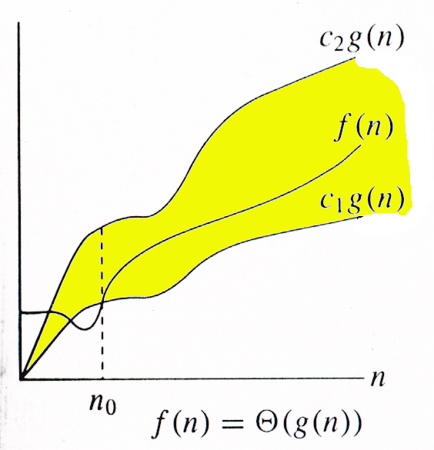
Θ-notation
For function g(n), we define Θ(g(n)), big-Theta of n, as the set:
Θ(g(n)) = {f(n) : ∃ positive constants c₁, c₂, and n_{0,} such that ∀n ≥ n₀,
we have 0 ≤ c₁g(n) ≤ f(n) ≤ c₂g(n)
}
Intuitively: Set of all functions that
have the same rate of growth as g(n).
g(n) is an asymptotically tight bound for f(n).

Slide 8
Θ-notation
For function g(n), we define Θ(g(n)), big-Theta of n, as the set:
Θ(g(n)) = {f(n) : ∃ positive constants c₁, c₂, and n_{0,} such that ∀n ≥ n₀,
we have 0 ≤ c₁g(n) ≤ f(n) ≤ c₂g(n)
}
Technically, f(n) ∈ Θ(g(n)).
Older usage, f(n) = Θ(g(n)).
I’ll accept either…
f(n) and g(n) are nonnegative, for large n.

Slide 9
Example
Θ(g(n)) = {f(n) : ∃ positive constants c₁, c₂, and n₀, such that ∀n ≥ n₀, 0 ≤ c₁g(n) ≤ f(n) ≤ c₂g(n)}
10n² - 3n = Θ(n²)
What constants for n₀, c₁, and c₂ will work?
Make c₁ a little smaller than the leading coefficient, and c₂ a little bigger.
To compare orders of growth, look at the leading term.
Exercise: Prove that n²/2-3n= Θ(n²)

Slide 10
Example
Θ(g(n)) = {f(n) : ∃ positive constants c₁, c₂, and n₀, such that ∀n ≥ n₀, 0 ≤ c₁g(n) ≤ f(n) ≤ c₂g(n)}
Is 3n³ ∈ Θ(n⁴) ??
How about 2^{2n}∈ Θ(2^{n})??

Slide 11
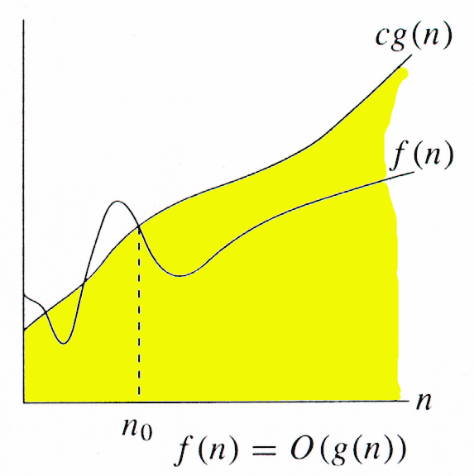
O-notation
For function g(n), we define O(g(n)), big-O of n, as the set:
O(g(n)) = {f(n) : ∃ positive constants c and n_{0,} such that ∀n ≥ n₀,
we have 0 ≤ f(n) ≤ cg(n) }
Intuitively: Set of all functions whose rate of growth is the same as or lower than that of g(n).
;f(n)=6n^3+5n^2+300n
;g(n)=n^3, O(n^3), c=311
g(n) is an asymptotic upper bound for f(n).
f(n) = Θ(g(n)) ⇒ f(n) = O(g(n)).
Θ(g(n)) ⊂ O(g(n)).

Slide 12
;f(n)=6n^3+5n^2+300n
;g(n)=n^3, O(n^3), c=311
O(n^3)→n^3, n^7/2, n^3logn, n^4, n^5……
Find O(f(n)) =?
f(n)=n^50 +2^(n+2) + 50000n
1) O(n^50) 2) O(2^(n+2)) 3) O(n) 4) O(2^n)

Slide 13
N^50, 2^n . Exponential term)constant ^variable>variable^constant(polynomial term)
N= 2^50
(2^50)^50=2^2500
…………………..
2^n=2^2^50=2^10000000000000000
2^50=2^10. 2^10. 2^10. 2^10. 2^10=10^15
2^n, 2^n+2
2^n+2= 2^n.2^2=O(2^n)

Slide 14
F(n)= 6n^3+5n^2+300n
G(n)=n^3
O(F(n) )=?
1).O(n^4)
2.O(n^2)
3.O(n^5)
4.O(n^10)

Slide 15
Examples
O(g(n)) = {f(n) : ∃ positive constants c and n₀, such that ∀n ≥ n₀, we have 0 ≤ f(n) ≤ cg(n) }
Any linear function an + b is in O(n²). How?
Show that 3n³=O(n⁴) for appropriate c and n₀.

Slide 16
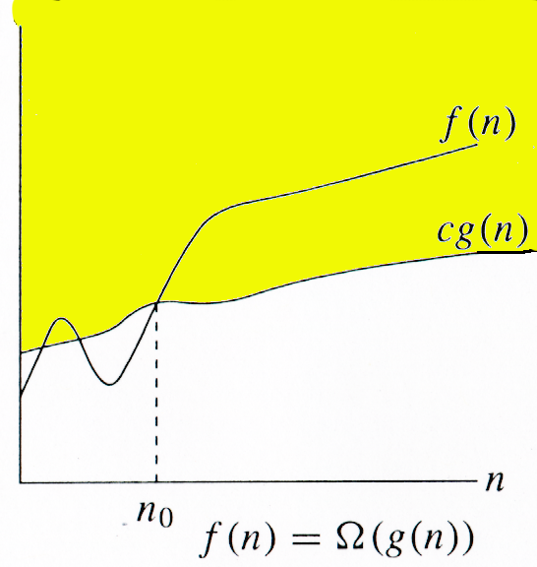
Ω -notation
For function g(n), we define Ω(g(n)), big-Omega of n, as the set:
Ω(g(n)) = {f(n) : ∃ positive constants c and n_{0,} such that ∀n ≥ n₀,
we have 0 ≤ cg(n) ≤ f(n)}
Intuitively: Set of all functions whose rate of growth is the same as or higher than that of g(n).
g(n) is an asymptotic lower bound for f(n).
f(n) = Θ(g(n)) ⇒ f(n) = Ω(g(n)).
Θ(g(n)) ⊂ Ω(g(n)).

Slide 17
Example
√n = Ω(lg n). Choose c and n₀.
Ω(g(n)) = {f(n) : ∃ positive constants c and n₀, such that ∀n ≥ n₀, we have 0 ≤ cg(n) ≤ f(n)}

Slide 18
Relations Between Θ, O, Ω

Slide 19
Relations Between Θ, Ω, O
Theorem : For any two functions g(n) and f(n), f(n) = Θ(g(n)) iff
f(n) = O(g(n)) and f(n) = Ω(g(n)).
I.e., Θ(g(n)) = O(g(n)) ∩ Ω(g(n))
In practice, asymptotically tight bounds are obtained from asymptotic upper and lower bounds.

Slide 20
Running Times
“Running time is O(f(n))” ⇒ Worst case is O(f(n))
O(f(n)) bound on the worst-case running time ⇒ O(f(n)) bound on the running time of every input.
Θ(f(n)) bound on the worst-case running time ⇒ Θ(f(n)) bound on the running time of every input.
“Running time is Ω(f(n))” ⇒ Best case is Ω(f(n))
Can still say “Worst-case running time is Ω(f(n))”
Means worst-case running time is given by some unspecified function g(n) ∈ Ω(f(n)).

Slide 21
Example
Insertion sort takes Θ(n²) in the worst case, so sorting (as a problem) is O(n²). Why?
Any sort algorithm must look at each item, so sorting is Ω(n).
In fact, using (e.g.) merge sort, sorting is Θ(n lg n) in the worst case.
Later, we will prove that we cannot hope that any comparison sort to do better in the worst case.

Slide 22
Asymptotic Notation in Equations
Can use asymptotic notation in equations to replace expressions containing lower-order terms.
For example,
4n³ + 3n² + 2n + 1 = 4n³ + 3n² + Θ(n)
= 4n³ + Θ(n²) = Θ(n³). How to interpret?
In equations, Θ(f(n)) always stands for an anonymous function g(n) ∈ Θ(f(n))
In the example above, Θ(n²) stands for 3n² + 2n + 1.

Slide 23
o-notation
For a given function g(n), the set little-o:
o(g(n)) = {f(n): ∀ c > 0, ∃ n₀ > 0 such that ∀ n ≥ n₀, we have 0 ≤ f(n) < cg(n)}.
f(n) becomes insignificant relative to g(n) as n approaches infinity:
lim [f(n) / g(n)] = 0
^{n→∞}
g(n) is an upper bound for f(n) that is not asymptotically tight.
Observe the difference in this definition from previous ones. Why?

Slide 24
ω -notation
For a given function g(n), the set little-omega:
ω(g(n)) = {f(n): ∀ c > 0, ∃ n₀ > 0 such that ∀ n ≥ n₀, we have 0 ≤ cg(n) < f(n)}.
f(n) becomes arbitrarily large relative to g(n) as n approaches infinity:
lim [f(n) / g(n)] = ∞.
^{n→∞}
g(n) is a lower bound for f(n) that is not asymptotically tight.

Slide 25
Properties
Symmetry
f(n) = Θ(g(n)) iff g(n) = Θ(f(n))
Complementarity
f(n) = O(g(n)) iff g(n) = Ω(f(n))
f(n) = o(g(n)) iff g(n) = ω((f(n))

Slide 26
Common Functions

Slide 27
Monotonicity
f(n) is
monotonically increasing if m ≤ n ⇒ f(m) ≤ f(n).
monotonically decreasing if m ≥ n ⇒ f(m) ≥ f(n).
strictly increasing if m < n ⇒ f(m) < f(n).
strictly decreasing if m > n ⇒ f(m) > f(n).
F(n)=4n^2+1
N=2,f(2)=17
N=3,37

Slide 28
Exponentials
Useful Identities:
Exponentials and polynomials

Slide 29
Logarithms
x = log_{b}a is the exponent for a = b^{x}.
Natural log: ln a = log_{e}a
Binary log: lg a = log₂a
lg²a = (lg a)²
lg lg a = lg (lg a)

Slide 30
Logarithms and exponentials – Bases
If the base of a logarithm is changed from one constant to another, the value is altered by a constant factor.
Ex: log₁₀ n * log₂10 = log₂ n.
Base of logarithm is not an issue in asymptotic notation.
Exponentials with different bases differ by a exponential factor (not a constant factor).
Ex: 2^{n} = (2/3)^{n}*3^{n}.

Slide 31
Polylogarithms
For a ≥ 0, b > 0, lim _{n→∞} ( lgª n / n^{b} ) = 0, so lgª n = o(n^{b}), and n^{b} = ω(lgª n )
Prove using L’Hopital’s rule repeatedly
lg(n!) = Θ(n lg n)
Prove using Stirling’s approximation (in the text) for lg(n!).

Slide 32
Exercise
Express functions in A in asymptotic notation using functions in B.
A B
5n² + 100n 3n² + 2
A ∈ Θ(B)
A ∈ Θ(n²), n² ∈ Θ(B) ⇒ A ∈ Θ(B)
log₃(n²) log₂(n³)
A ∈ Θ(B)
log_{b}a = log_{c}a / log_{c}b; A = 2lgn / lg3, B = 3lgn, A/B =2/(3lg3)
n^{lg4} 3^{lg n}
A ∈ ω(B)
a^{log b} = b^{log a}; B =3^{lg n}=n^{lg 3}; A/B =n^{lg(4/3)} → ∞ as n→∞
lg²n n^{1/2}
A ∈ ο (B)
lim ( lgª n / n^{b} ) = 0 (here a = 2 and b = 1/2) ⇒ A ∈ ο (B)
^{n→∞}

Slide 33
Summations – Review

Slide 34
Review on Summations
Why do we need summation formulas?
For computing the running times of iterative constructs (loops). (CLRS – Appendix A)
Example: Maximum Subvector
Given an array A[1…n] of numeric values (can be positive, zero, and negative) determine the subvector A[i…j] (1≤ i ≤ j ≤ n) whose sum of elements is maximum over all subvectors.
1 | -2 | 2 | 2

Slide 35
Review on Summations
MaxSubvector(A, n)
maxsum ← 0;
for i ← 1 to n
do for j = i to n
sum ← 0
for k ← i to j
do sum += A[k]
maxsum ← max(sum, maxsum)
return maxsum
_{n n j}
T(n) = ∑ ∑ ∑ 1
^{i=1 j=i k=i}
NOTE: This is not a simplified solution. What is the final answer?

Slide 36
Review on Summations
Constant Series: For integers a and b, a ≤ b,
Linear Series (Arithmetic Series): For n ≥ 0,
Quadratic Series: For n ≥ 0,

Slide 37
Review on Summations
Cubic Series: For n ≥ 0,
Geometric Series: For real x ≠ 1,
For |x| < 1,

Slide 38
Review on Summations
Linear-Geometric Series: For n ≥ 0, real c ≠ 1,
Harmonic Series: nth harmonic number, n∈I⁺,

Slide 39
Review on Summations
Telescoping Series:
Differentiating Series: For |x| < 1,

Slide 40
Review on Summations
Approximation by integrals:
For monotonically increasing f(n)
For monotonically decreasing f(n)
How?

Slide 41
Review on Summations
nth harmonic number

Slide 42
Reading Assignment
Chapter 4 of CLRS.

